Slide 1
Permissions, more joins, EXPLAIN

Slide 2
UPDATE…JOIN
When you need to update data in a table based on values in another table. In this case, you can use the PostgreSQL UPDATE join syntax as follows:
UPDATE t1
SET t1.c1 = new_value
FROM t2
WHERE t1.c2 = t2.c2;
Example:
drop table if exists public.test_update_join;
create table public.test_update_join as select * from bookings.flights where actual_departure between '2016-07-01' and '2016-09-01';
alter table public.test_update_join add pass_cnt int;
update public.test_update_join test set pass_cnt = t.pass_cnt
from (select f.flight_id, count (distinct bp.boarding_no) as pass_cnt
from bookings.flights f join bookings.ticket_flights tf on tf.flight_id = f.flight_id
join bookings.boarding_passes bp on bp.ticket_no = tf.ticket_no and bp.flight_id = tf.flight_id
where f.actual_departure between '2016-07-01' and '2016-09-01'
group by f.flight_id) t
where test.flight_id = t.flight_id
returning test.flight_id, t.pass_cnt;

Slide 3
DELETE…JOIN
You can use complex Joins with DELETE, not only subqueries, IN and = clauses.
PostgreSQL doesn’t support the DELETE JOIN statement. However, it does support the USING clause in the DELETE statement that provides similar functionality as the DELETE JOIN.
General syntax:
DELETE FROM table_name1
USING table_expression
WHERE condition
RETURNING returning_columns;
Example:
drop table if exists public.test_delete_join;
create table public.test_delete_join as select * from bookings.flights where actual_departure between '2016-07-01' and '2016-09-01';
delete from public.test_delete_join test
using public.b_el_paso_flights paso
where test.arrival_airport = paso.airport_code and test.actual_departure::date = paso.departure_date
returning *;

Slide 4
RETURNING
The RETURNING keyword in PostgreSQL gives you an opportunity to return, from the insert or update statement, the values of any columns after the insert or update was run.
You can combine non-changed columns with changed
You can do calculations with columns in RETURNING

Slide 5
Permissions, GRANT
Each object in a database (and database itself) has an owner
You can GRANT and REVOKE various permissions on objects across roles (and users)
User and role in Postgres are the same, but user has login privilege by default
--connect as postgres user and execute:
drop user if exists booking_role;
--create a role (user) with password
CREATE USER booking_role password 'book1';
--grant everything on schema (but only schema, not its objects!)
GRANT ALL ON SCHEMA bookings TO booking_role;
--grant ALL on all tables in schema
GRANT ALL ON ALL TABLES in schema bookings TO booking_role;
--grant select on specific table
grant select on table public.boryspil_flights to booking_role;
grant select (airport_code, city) on table public.b_el_paso_flights to booking_role;
--let’s connect with booking_role and try to delete something from boryspil_flights
delete from public.boryspil_flights where flight_company = 'UIA';
--and observe the error

Slide 6
Permissions, REVOKE
REVOKE does opposite to GRANT – takes user’s permissions away
You can grant and revoke many permissions in one statement
revoke select on table public.boryspil_flights from booking_role;
revoke all on all tables in schema public from booking_role;
revoke insert, update, delete on all tables in schema bookings from booking_role;
Get the list of user’s permissions on tables:
select *
from information_schema.role_table_grants
where grantee='booking_role';

Slide 7
EXPLAIN
EXPLAIN lets you see a query execution plan
Adding ANALYZE lets you to actually perform a query, but without an impact to the database. Without ANALYZE, cached plan data might be used
EXPLAIN [ANALYZE] <query>
explain analyze select * from public.test_delete_join where arrival_airport = 'JFK';
create index ix_test_join_arr_airport on public.test_delete_join (arrival_airport);
explain analyze select * from public.test_delete_join where arrival_airport = 'JFK';
Execution cost is provided in ephemeral “parrots”. However, you can compare the cost for the same tables and results you’re querying.
Pay attention to table scans (especially for large tables), proper indexes usage
Sorting (even if you haven’t asked for it) can cost a lot

Slide 8
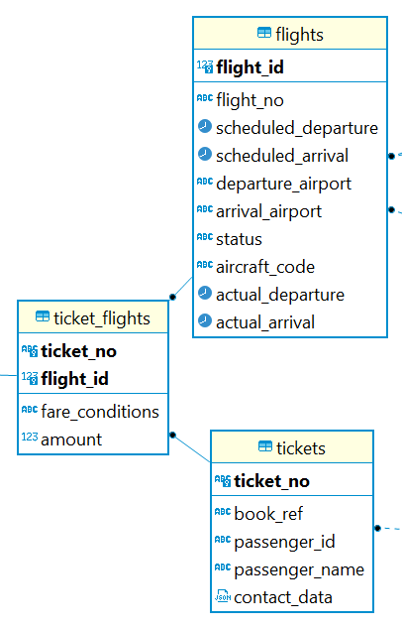
Many-to-many relationships
A many-to-many (or M:N) relationship is one of the three database relationships. The other two are:
One-to-one (1:1) relationships
One-to-many (1:N) relationships
By definition, a many-to-many relationship is
where more than one record in a table is
related to more than one record in another table.
On the picture: many tickets can correspond to many flights. That’s why “bridge” table ticket_flights is added.
*We assume that one ticket (or booking) can contain many flight segments.

Slide 9
Q&A/Homework
Create a user reporter. Grant him permissions to select data from all objects in bookings schema. Then revoke grants for select on tables: boarding_passes, tickets, bookings. Test the changes under reporter connection.
Create a new table as SELECT * FROM booking.flights. Add 2 new columns: economy_avg and business_avg. Update a table by filling these new columns: average # of Economy and Business seats occupied per corresponding date (use scheduled_departure column as reference).
3. Take the table you created in #2 and delete from it data for 50 worst performing airports (they have less flights).
*Optional: try to use CTEs.

Slide 10
Links to read
https://www.postgresqltutorial.com/postgresql-delete-join/
https://www.postgresqltutorial.com/postgresql-update-join/
https://www.postgresqltutorial.com/postgresql-administration/postgresql-grant/
https://www.techonthenet.com/postgresql/grant_revoke.php
https://medium.com/@emekadc/how-to-implement-one-to-one-one-to-many-and-many-to-many-relationships-when-designing-a-database-9da2de684710
https://code.tutsplus.com/articles/sql-for-beginners-part-3-database-relationships--net-8561
https://thoughtbot.com/blog/reading-an-explain-analyze-query-plan
https://www.postgresqltutorial.com/postgresql-explain/

